Slide 1
Avionics System for UAV Flight Controls Research
Ohanes Dadian and Ajay Bettadapura
California State Polytechnic University, Pomona
AIAA Infotech@Aerospace 2013, 08/19/2013, Boston Marriott Copley

Slide 2
Overview
Research Objectives
CPP UAV Lab
Avionics System Architecture
Flight Controls
Summary
Future Work
Acknowledgement

Slide 3
Research Objectives
Development of custom open modular avionics system
Development and validation of flight dynamics models for the UAVs
Development, simulation, system integration, and flight testing of Guidance, Navigation, and Control (GN&C) algorithms
The overall goal of the ongoing research is the development and verification of neural adaptive controllers for UAVs

Slide 4
Cal Poly Pomona UAV Lab
More than 15 airplane and helicopter UAVs
  R-MAX, SR-100, Raptor 90 helicopter
  Twin-Engine, Telemaster, Sig Kadet Senior Airplanes
  Quadrotors and hexacopters
Sensors and associated equipment
  GPS Integrated IMU, Differential GPS
  Single Board Computers, Microcontrollers
  Air Data Probes
  Piccolo Autopilots, Micropilots, Ardupilots

Slide 5
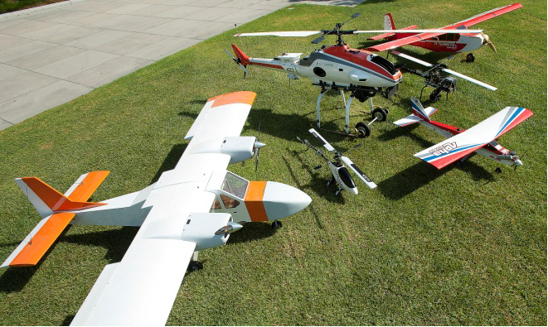
Cal Poly Pomona UAV Fleet

Slide 6
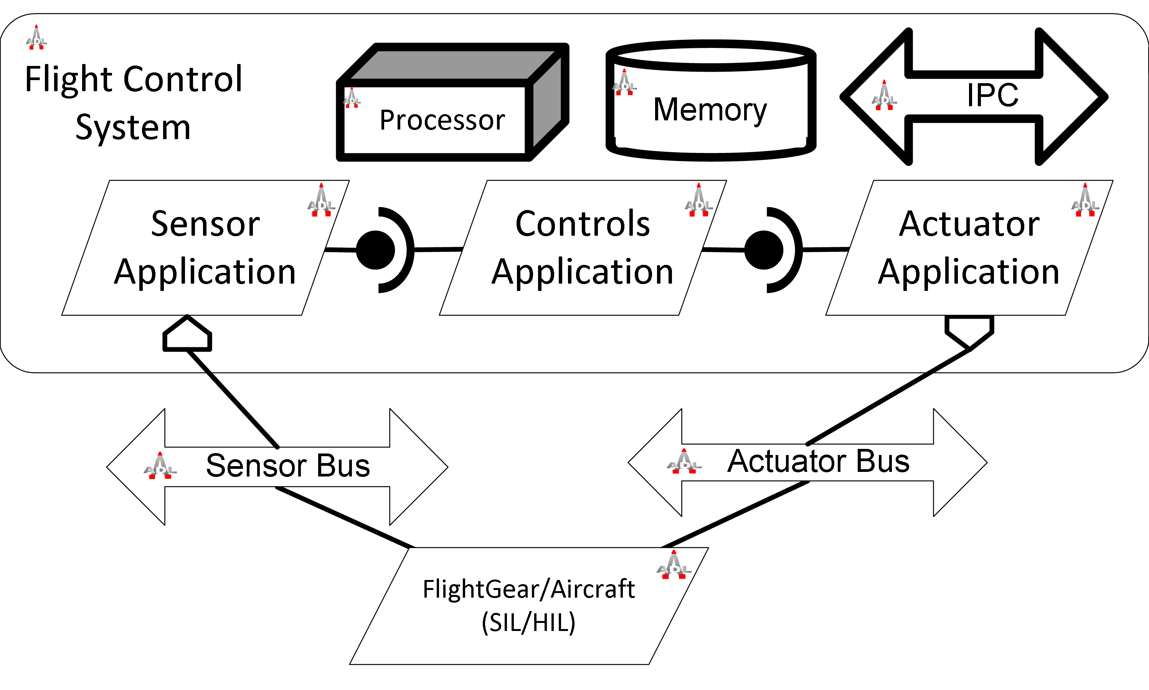
Avionics System Architecture

Slide 7
Avionics System Architecture (Contd.)
Utilize common set of processing modules based on Integrated Modular Avionics (IMA)
Supports high availability, I/O, messaging, process management
  Based on ARINC 653
Hardware? talk

Slide 8
Data Concentrator Module
Designed to support flight management and control systems in a single unit
Supports software-defined radars and radios
Design includes a FPGA and HPS
  Modular
  Reconfigurable
  Powerful

Slide 9
Common Processing Module
Provides integer and floating-point performance for flight applications
  User-level applications
  Artificial Intelligence
  Data Processing
  Behavior Generation
  Vehicle Management

Slide 10
Current Implementation
NetGear 5-port Ethernet Switch
AAEON PFM-CVS PC-104 computer
  Intel Atom N2600 processor
  12 VDC power requirement
  3 Cell Lithium Polymer (LiPo) battery
  1 Gigabit Ethernet port
  4 USB ports
  VGA port

Slide 11
Current Implementation (Contd.)
Technologic Systems TS-7700
  Used as data concentrator
  Lattice XP2 8K Look-Up-Table (LUT) FPGA
  Marvell PXA166 ARM9 processor
    1.066 GHz
  Real-Time Clock
  Ethernet and USB Ports
  55 FPGA discrete I/O pins
  Dual-redundant SD cards

Slide 12
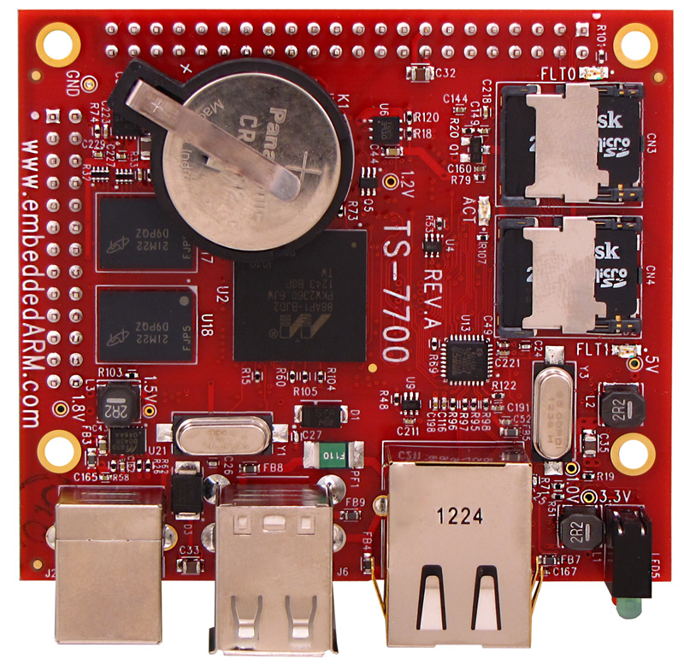
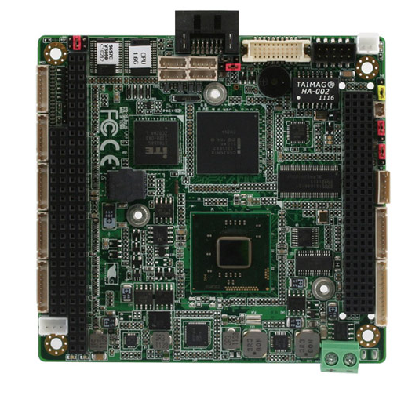
Hardware
Data Concentrator
Common Processing Module

Slide 13
RTOS for Fight Computer
QNX Neutrino RTOS
  Organized documentation
  Momentics Integrated Development Environment (IDE)
  Fault Tolerant Micro-kernel
Provides time/space partitioning, message-passing, fast context switching, low interrupt latency, and POSIX compliance

Slide 14
RTOS for FPGA Softcore Processor
Real-Time Executive for Multiprocessor Systems
  Supports LEON3 SPARC
  Heavily tested on aerospace systems

Slide 15
Software Architecture
A middleware layer sits atop the Neutrino's microkernel for performing the following
  Scheduling
  Process Management
  Blackboard
  Message Queues
  Protocol Libraries
  Unified Link API

Slide 16
Ground Control Station
A software system to monitor and control aircraft
Situational awareness
Avionics configuration
Mission planning
Data logging
Manual Override

Slide 17
Ground Control Station (Contd.)
Communication over Stanag 4586
Message passing via XBEE transceivers
  ZigBee 802.15.4 specification
Data consistency through SQL-based databases
Developed with C++ and Qt
Supports Linux, Mac OS X, Windows

Slide 18
Flight Controls
Cal Poly Pomona is developing and testing controllers based on various techniques
  Non-linear Dynamic Inversion
  Brain Emotional Learning Based Intelligent Controllers
  Lyapunov backstepping
  Linear State Space methods
  Neural Networks

Slide 19
Neural Networks
There are many classes of existing neural networks
  Feed-forward
  Recurrent
  etc…
A feed-forward and recurrent controller are currently being developed for use in UAV projects

Slide 20
Neural Networks (Contd.)
The feed-forward model is being developed as a Multi-Layer Perception
  Simple to implement
  Optimal for offline learning
The recurrent model is being developed as an Echo State Network
  More difficult to implement
  Optimal for online learning

Slide 21
Echo State Network
Reservoir-based Computing
  Great for non-linear learning
Input and Output layers are linear
Hidden Layer is non-linear
  Sparsely connected
  Neuron activation via hyperbolic tangent function
  Linear regression for output phase via Wiener-Hopf method

Slide 22
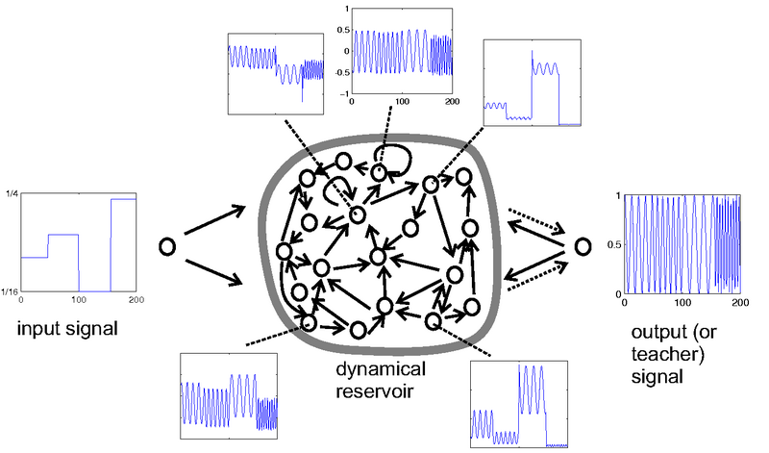
Echo State Network (Contd.)

Slide 23
Echo State Network (Contd.)
Learning is supervised by a teacher signal
Employs a 10% leak rate and 10% connectivity between neurons
Prototyped in MATLAB and developed in C++
Supports Linux, Mac OS X, Windows

Slide 24
Controller Implementation

Slide 25
Software/Hardware-in-the-Loop
Verification & Validation (V&V) of autopilot system
  No risk of damaging aerial platforms
  Controllers are tuned in simulation before flight tests
    Limits possibility of unstable behavior
SIL Simulation performed with FlightGear

Slide 26
Software/Hardware-in-the-Loop (Contd.)
TwinEngine simulated model
  Sent a 20 degree left bank command
  Roll PID engaged after stabilization
  Rise time – .428 seconds
  Settling time – 1.57 seconds
  Max overshoot – 5.19%

Slide 27
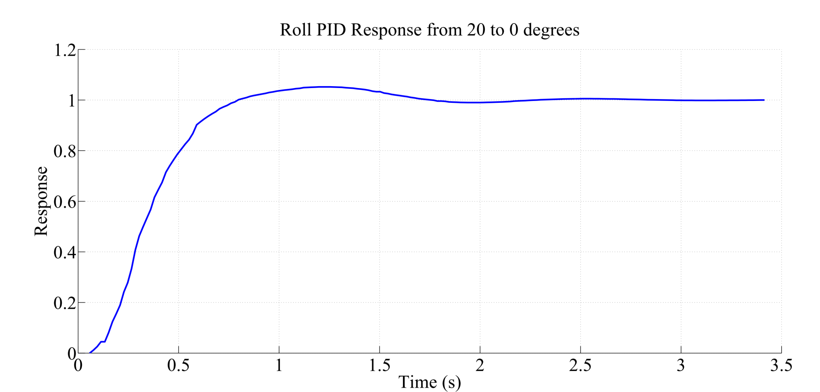
Software/Hardware-in-the-Loop Contd.

Slide 28
Software/Hardware-in-the-Loop (Contd.)
Hardware-in-the-Loop
  Common processor / Data concentrator hosts flight control application and connects to modules responsible for acquisition and actuation
  Sensor data is fed from FlightGear to state estimation algorithms for verification
  Actuator operation will be checked and control surface actuation will be performed

Slide 29
Summary
Open avionics system developed to support UAV projects at Cal Poly
Reference architecture is almost completed
GUI for ground control is still under development
Research on AI techniques for flight control will continue
Much work still needs to be done

Slide 30

Questions & Answers

Slide 31


